Slide 1
Machine vision – Different filters
Dr. Mikael Ericsson
2025
Notes:
Exempelsidorna som följer visa hur layouten är tänkt med bilder och layoutflöde.
Under ”Ny bild”¹ finns fler layoutmallar² än de som ligger på exempelsidorna nedan.
1.
2.

Slide 2
Q & A session Robot system 250922
Dr. Mikael Ericsson
2025
Notes:
Exempelsidorna som följer visa hur layouten är tänkt med bilder och layoutflöde.
Under ”Ny bild”¹ finns fler layoutmallar² än de som ligger på exempelsidorna nedan.
1.
2.

Slide 3
Filter
Linear filter
Weighted sums
Gaussian smoothing filter
Non-linear filter
Everything else, such as the Median filter

Slide 4
Types of neibourhood
4 neighbours
8 neighbours

Slide 5
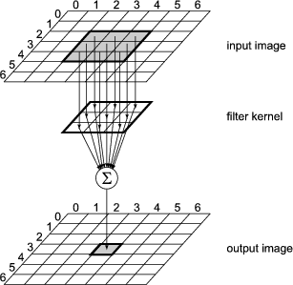
Moving window
Input image
Filter kernel
Output image

Slide 6
Filter types
Smoothing filter - Low pass filter used to suppress noise
Are based on average, all pixels with the same weight
Destroys edges
Gaussian filter
Optimal smoothing filter
Using integral filter weights
Kernel sizes 3x3 or 5x5 or bigger
Can be customized
Median Filter
Are effective in removing salt and pepper noise
Sorting and selecting the median pixel value by grey level
Time-consuming due to the sorting of all pixels

Slide 7
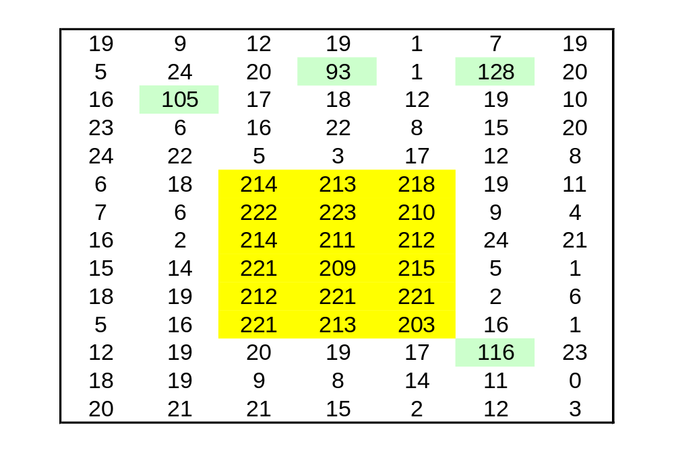
Example

Slide 8
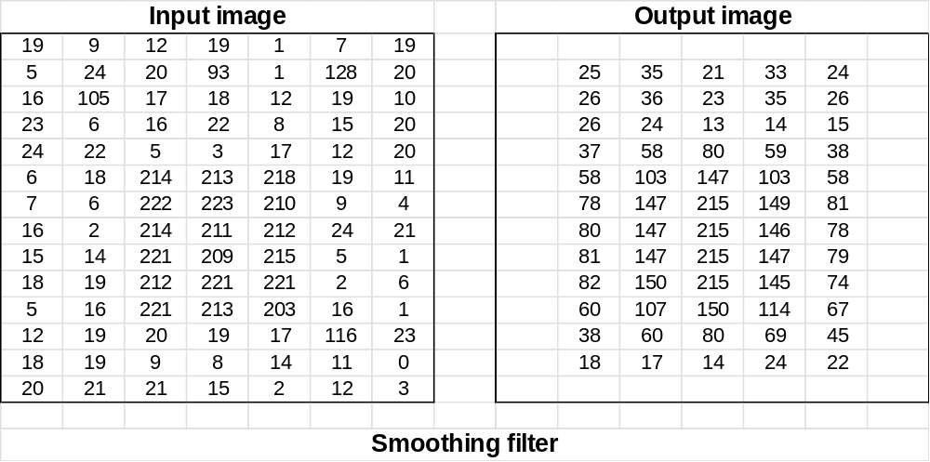
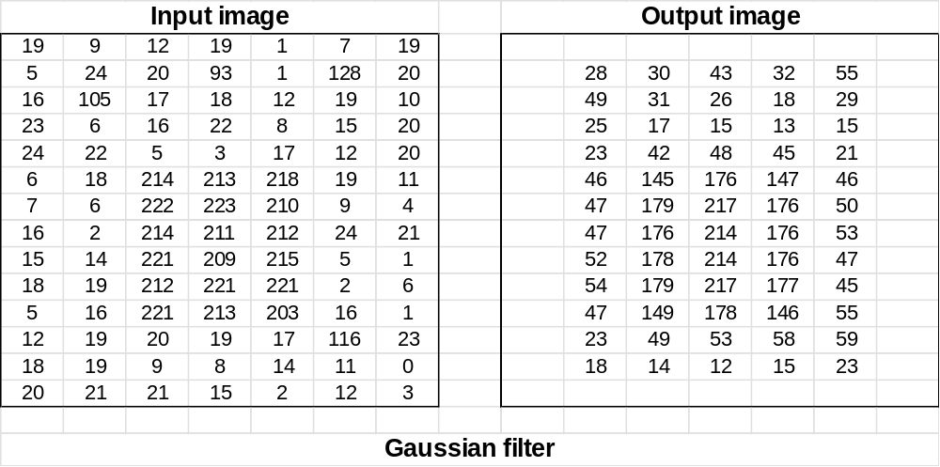
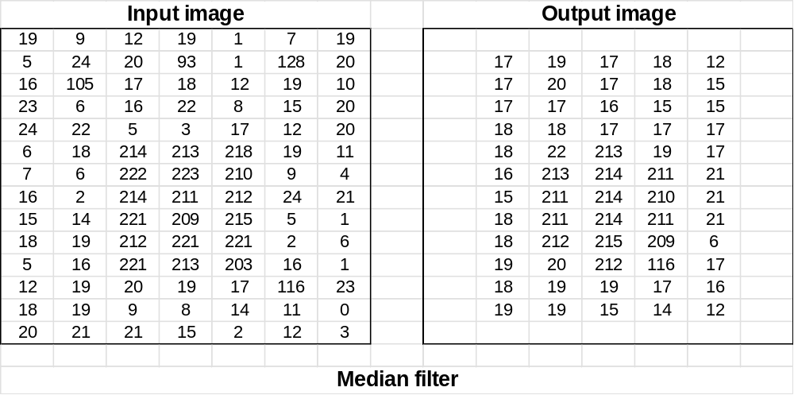
Comparison filter results

Slide 9
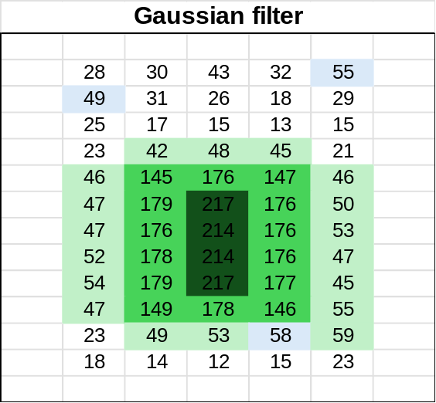
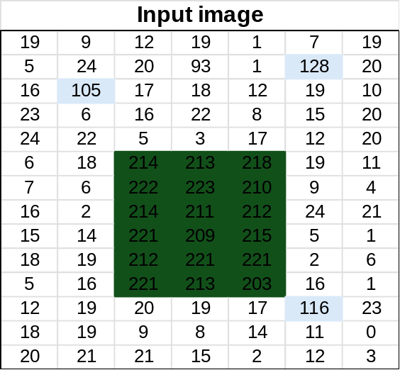
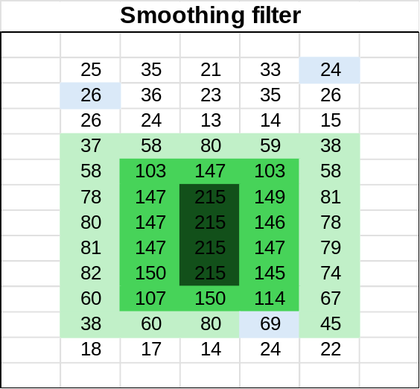
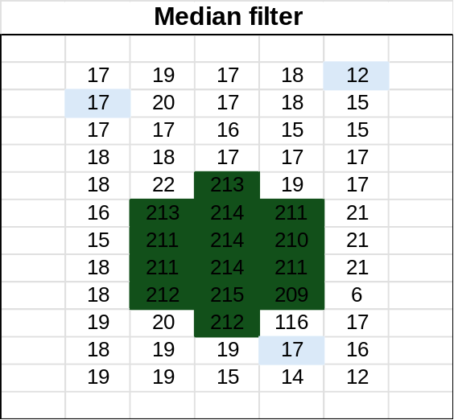
Summary different filters
Comparison between filters
Smoothing
Gaussian
Median

Slide 10
Comments
All filters remove/reduce the noise
The smoothing filter destroys the border most
Median destroys corners

